Slide 1
Channels in golang
goroutines sync

Slide 2
goroutines are not threads
goroutines are super fast
goroutines are non-blocking
use runtime.GOMAXPROCS(n) to define threads amount

Slide 3
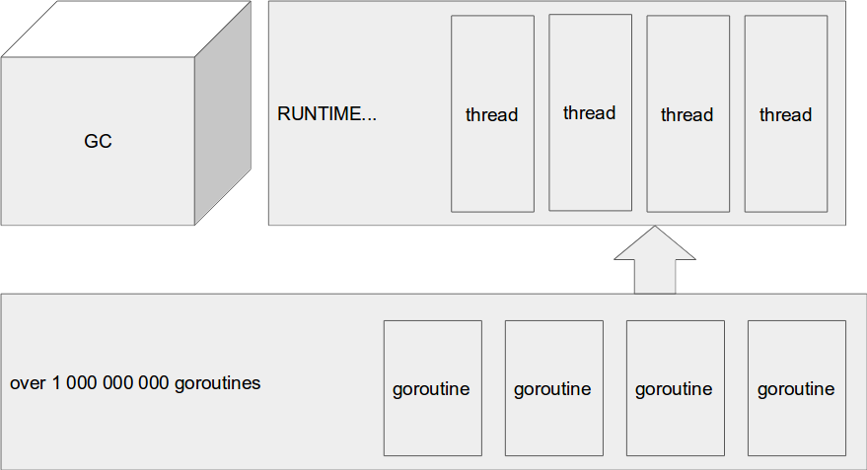

Slide 4
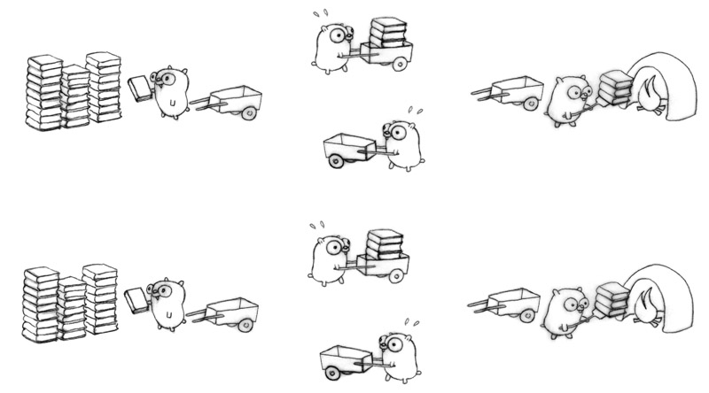

Slide 5
Channels

Slide 6
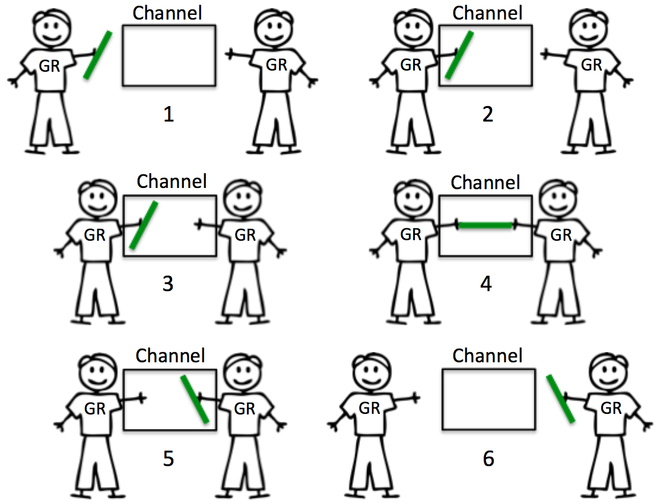

Slide 7
Buffered channels

Slide 8
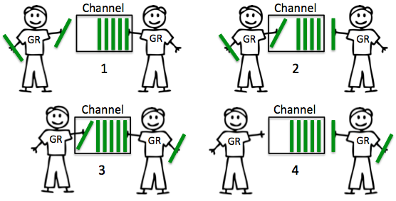

Slide 9
Requests per seconds
create RSP_CHANNEL for counting
receive request
send current time to RSP_CHANNEL
accumulate data in storage
send those metrics to database by timer
профит

Slide 10
IT Community Nikolaev
Ищенко Виталий
fred.doorst@gmail.com
https://github.com/itnikolaev/chandemo.git

